Slide 1
Critical Thinking

Slide 2
Introduction
Critical thinking is a disciplined process involving analysis, evaluation, and synthesis of information. It is essential for making well-informed decisions, solving complex problems, and fostering clear understanding in professional environments. Developing these skills enhances strategic thinking and reduces bias in judgment.

Slide 3

Definition and Importance
Critical thinking is the ability to objectively analyze facts to form a judgment. It involves questioning assumptions, evaluating evidence, and recognizing biases. Mastering this skill leads to better decision-making, improved problem-solving capabilities, and greater professional effectiveness.

Slide 4
Key Components
The key components of critical thinking include analysis, evaluation, and inference. These allow individuals to dissect information, assess credibility, and draw logical conclusions. Cultivating these elements promotes clarity and accuracy in reasoning, essential in corporate settings.

Slide 5

Application in Problem Solving
Applying critical thinking in problem solving involves defining the problem clearly, generating possible solutions, and evaluating their effectiveness. This approach minimizes risks and supports innovation by challenging assumptions, encouraging creativity, and ensuring decisions are based on evidence and logic.

Slide 6
Key Principles of Critical Thinking
Clarity: Ensuring ideas are expressed clearly and without ambiguity, by defining terms and understanding the problem at hand.
Accuracy: Verifying the truthfulness of information and claims, questioning the validity of sources and seeking evidence.
Precision: Providing detailed and exact information to support arguments, avoiding generalizations and misunderstandings.
Relevance: Focusing on information that directly pertains to the issue, assessing whether it contributes to solving the problem.
Depth: Recognizing the complexities of issues and considering multiple factors that may influence outcomes.
Breadth: Considering different viewpoints and perspectives to gain a comprehensive understanding of the issue.

Slide 7
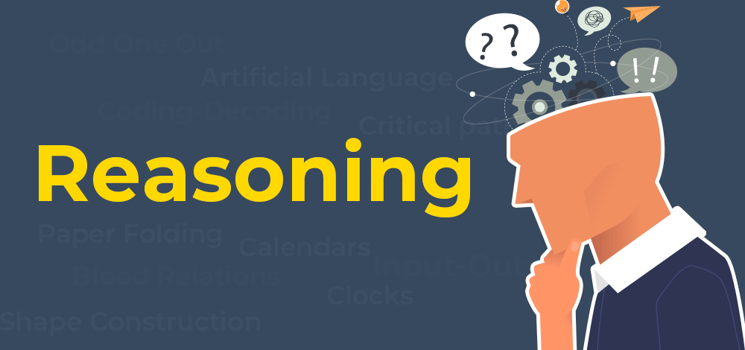
Reasoning
Reasoning is the act of using existing information to reach a conclusion, make a prediction, or construct an explanation. In logic, we evaluate reasoning based on how strongly the premises support the conclusion.

Slide 8
Deductive Reasoning (Certainty)
Deductive reasoning moves from general principles to a specific conclusion. If the premises are true and the structure is correct, the conclusion must be true. It aims for 100% certainty.
Key Concept
Validity - An argument is "valid" if the conclusion follows logically from the premises, even if the premises themselves are factually false.
Soundness - An argument is "sound" only if it is valid and the premises are factually true.
Inductive Reasoning (Probability)
Inductive reasoning moves from specific observations to a general conclusion. It doesn't claim to be 100% certain; instead, it claims that the conclusion is likely or probable.
Key Concept
Strength - We don't call inductive arguments "valid"; we call them strong or weak based on how likely the conclusion is.
Cogency - Aninductive argument is "cogent" if it is strong and the premises are actually true.

